Slide 1
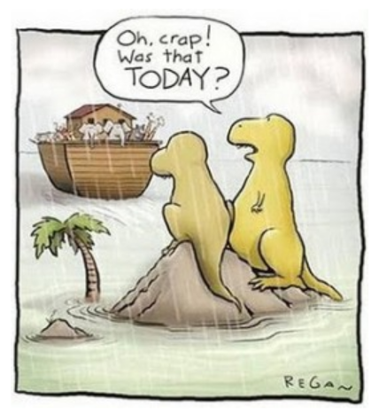
Speciation and Extinction

Slide 2
Why species are where they are?
The species originated there
(Speciation)
Species present
The species was never there
(Dispersal)
The species move there
(Dispersal)
Species absent
The species went extinct
(Extinction)
At the most basic level, speciation, extinction and/or dispersal can explain why species are where they are

Slide 3
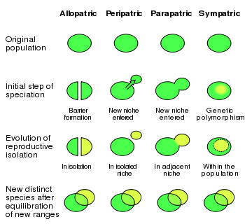
SPECIATION
The origin of a new species

Slide 4
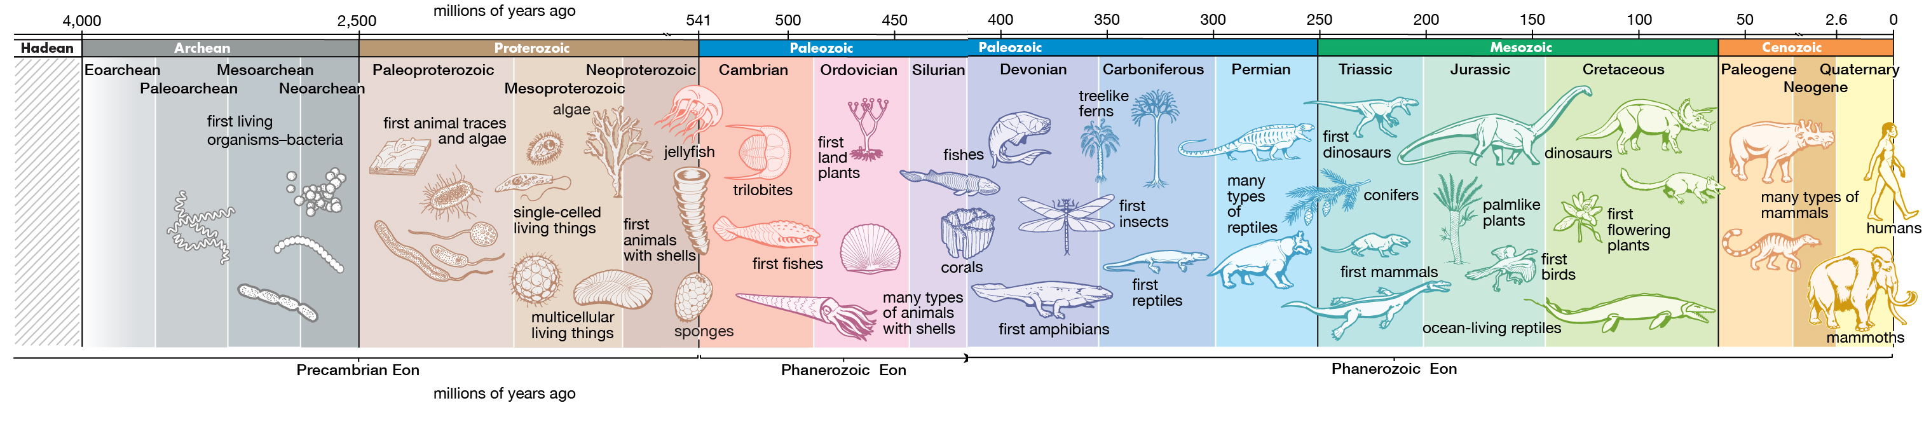
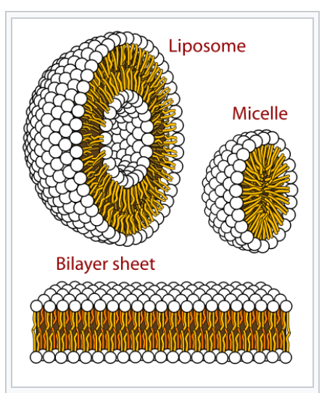

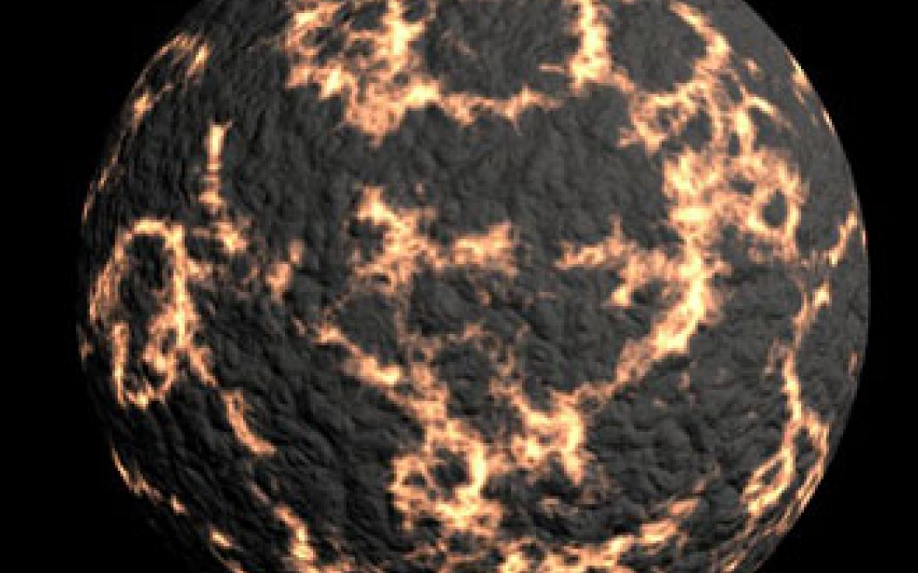
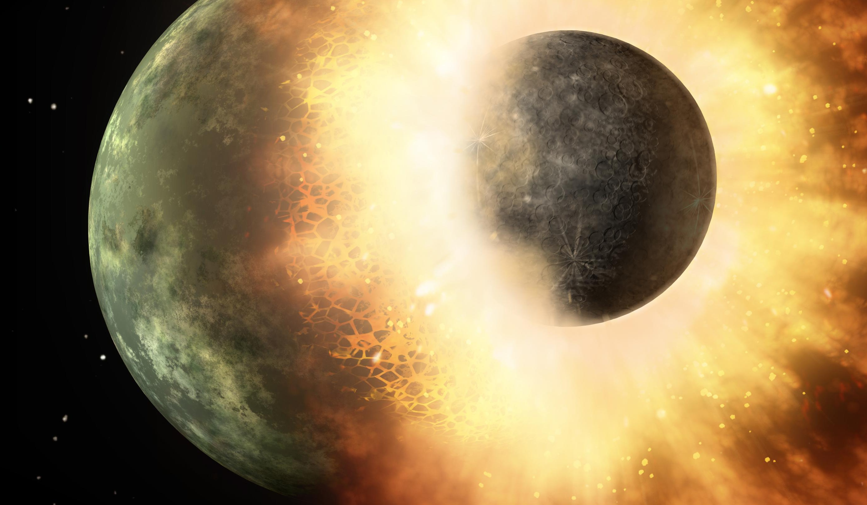
The very very beginning
Protocells
3.5b yr
4.6b yr
4.5b yr
Earth
Moon

Slide 5
Where?
Inukjuak, Quebec (3)
Glazier (1)
Pilbara, Western Australia (2)
1. Schopf, J. William (29 June 2006). "Fossil evidence of Archaean life". Philosophical Transactions of the Royal Society B. London: Royal Society. 361 (1470): 869–885
2. Noffke, Nora; Christian, Daniel; Wacey, David; Hazen, Robert M. (16 November 2013). "Microbially Induced Sedimentary Structures Recording an Ancient Ecosystem in the ca. 3.48 Billion-Year-Old Dresser Formation, Pilbara, Western Australia". Astrobiology. New Rochelle, NY: Mary Ann Liebert, Inc. 13 (12): 1103–1124
3. Dodd, Matthew S.; Papineau, Dominic; Grenne, Tor; Slack, John F.; Rittner, Martin; Pirajno, Franco; O'Neil, Jonathan; Little, Crispin T. S. (1 March 2017). "Evidence for early life in Earth’s oldest hydrothermal vent precipitates". Nature. 543: 60–64
Schopf, J. William (29 June 2006). "Fossil evidence of Archaean life". Philosophical Transactions of the Royal Society B. London: Royal Society. 361 (1470): 869–885

Slide 6
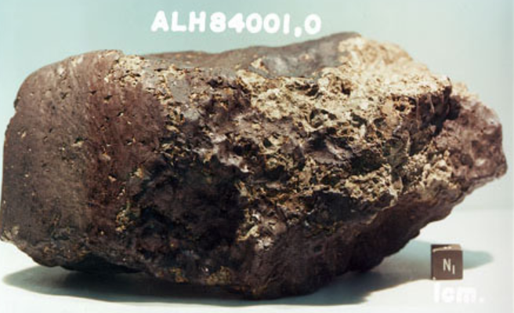
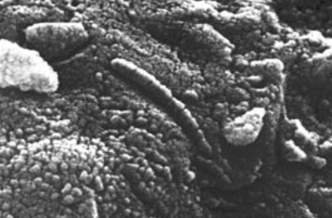
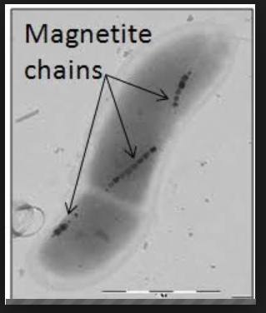
Mars: Panspermia
McKay DS; Gibson EK; Thomas-Keprta KL; et al. (August 1996). "Search for past life on Mars: possible relic biogenic activity in martian meteorite ALH84001". Science. 273 (5277): 924–30

Slide 7
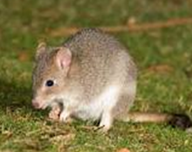

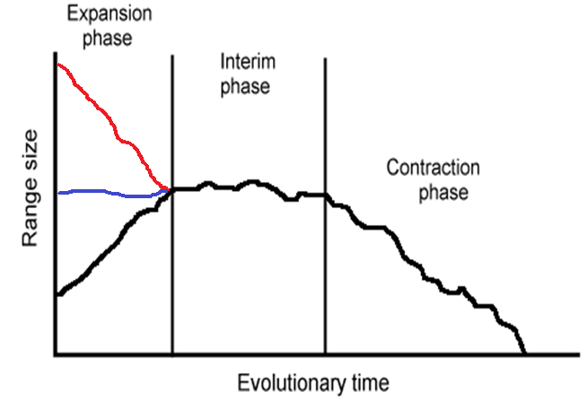
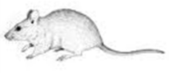

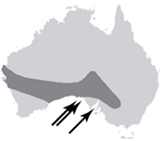
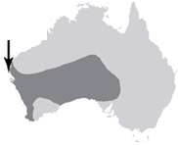
How species go extinct?
Outward
Inward
Why will this be important?
Allopatric
How does it occur?
Sympatric
Of 245 species analyzed, 98% maintained populations in at least a portion of their peripheral range before going extinct (Channell & Lomolino, Nature 2000)
Peripatric
Extinction: lost of the last individual of a species

Slide 8

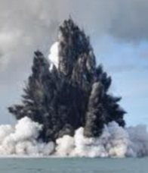
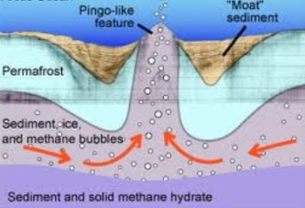
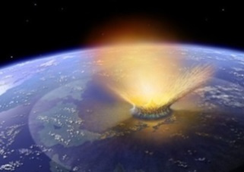
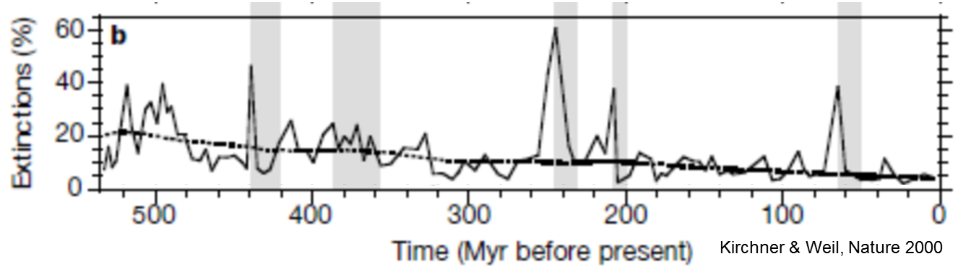
Some facts about extinction
0.1% extant
Glaciation
Volcanism
Methane
Meteorites
99.9% extinct
Of all species that have existed on Earth, 99.9% are now extinct.
?
Over the past half billion years, there have been at least twenty mass extinctions. Five of these were major—the so-called Big Five
Notes:
he clathrate gun hypothesis is the popular name given to the hypothesis that rises in sea temperatures (and/or falls in sea level) can trigger the sudden release of methane from methane clathrate compounds buried in seabeds and permafrost which, because the methane itself is a powerful greenhouse gas, leads to further temperature rise and further methane clathrate destabilization – in effect initiating a runaway process as irreversible, once started, as the firing of a gun

Slide 9
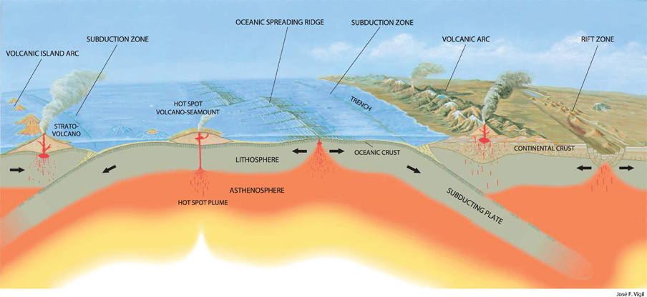
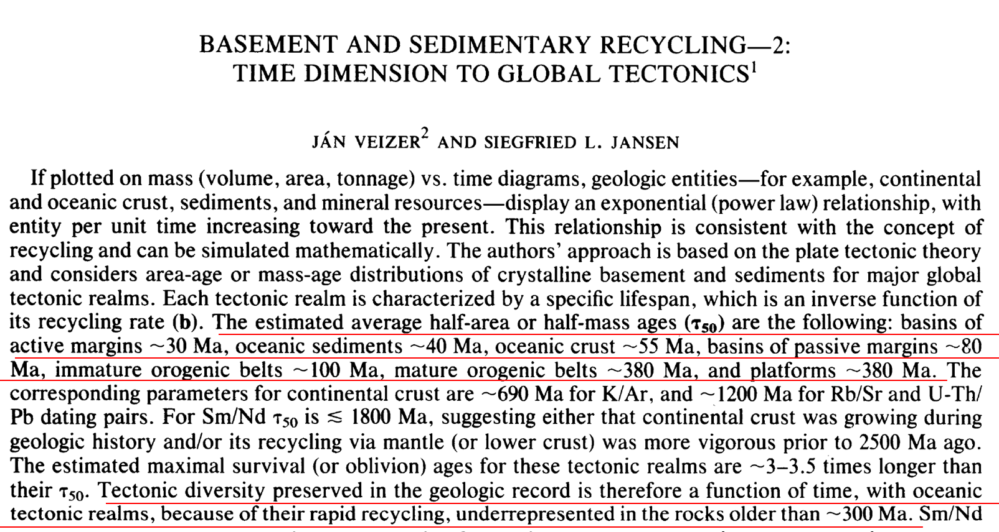
Why a lack of evidence: recycling of fossils due to plate tectonics.
The Journal of Geology 93, no. 6 (Nov., 1985): 625-643.

Slide 10
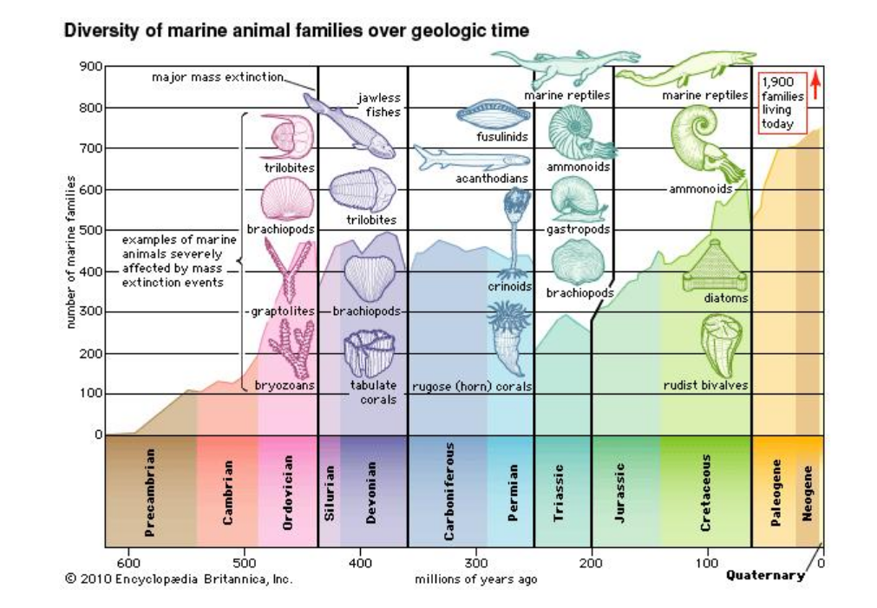
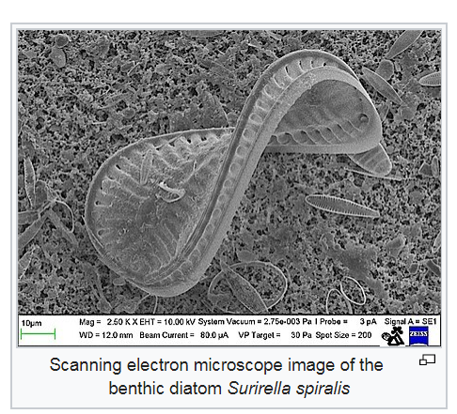
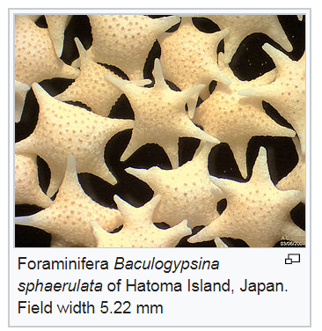
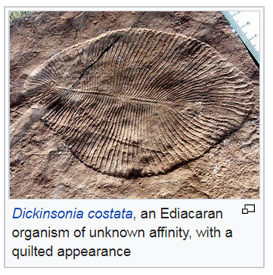
Additional explanation: species capable of leaving fossil only emerged recently
Cambrian explosion
Diatoms
Forams

Slide 11
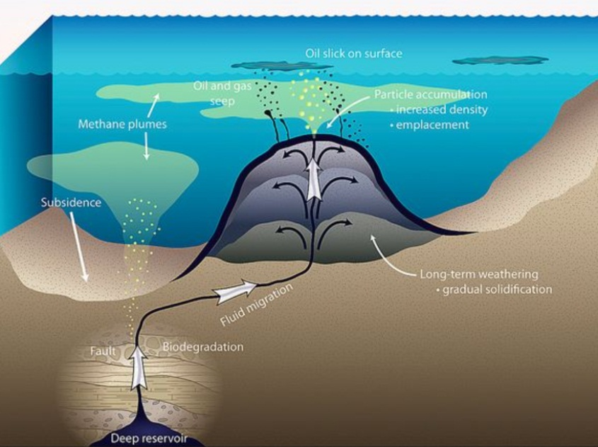
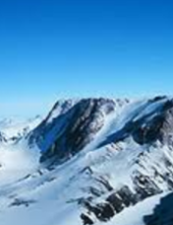
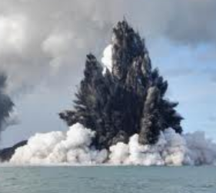
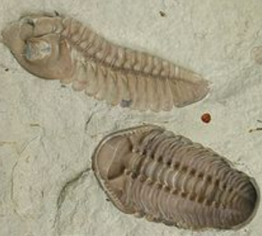

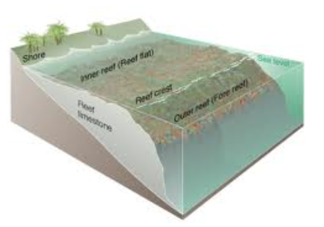
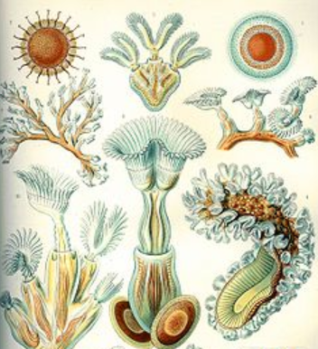
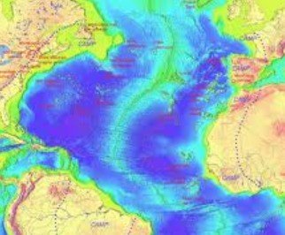
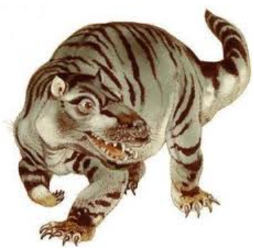
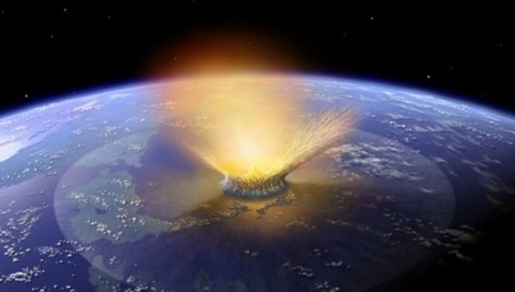
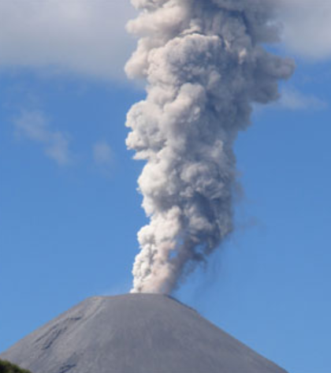
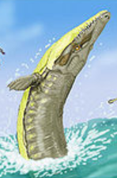
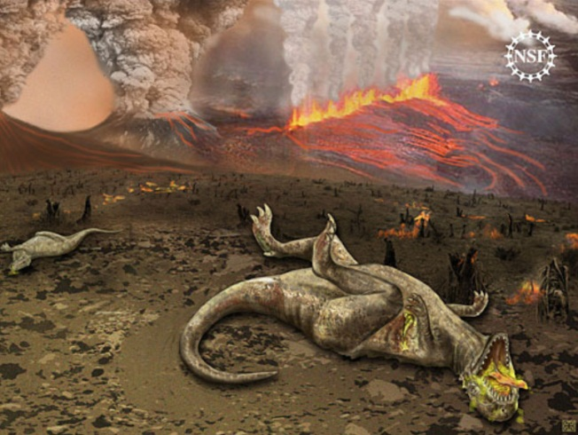
The Big Five
Ocean anoxia, possibly triggered by global cooling or oceanic volcanism, among main suggested causes
Sea level and glacially-driven cooling among suggested causes of this extinction event
Ordovician–Silurian event, the second largest of the five major extinctions on Earth, more than 60% of marine invertebrates died including brachiopods, bivalves, echinoderms, bryozoans and corals.
Late Devonian, ~ 70% of all species at the time went extinct, the event was more catastrophic in the ocean and included trilobites and coral-like organisms.
Permian–Triassic event, "Great Dying“, ~96% of all marine species and ~ 70% of land species at the time went extinct including large mammal-like reptiles and most insects
Triassic–Jurassic event, at least half of the species at that time went extinct including the large amphibians and some reptiles crocodile-like
End-Cretaceous event, seventy-five per cent of all species on earth were exterminated including the dinosaurs

Slide 12
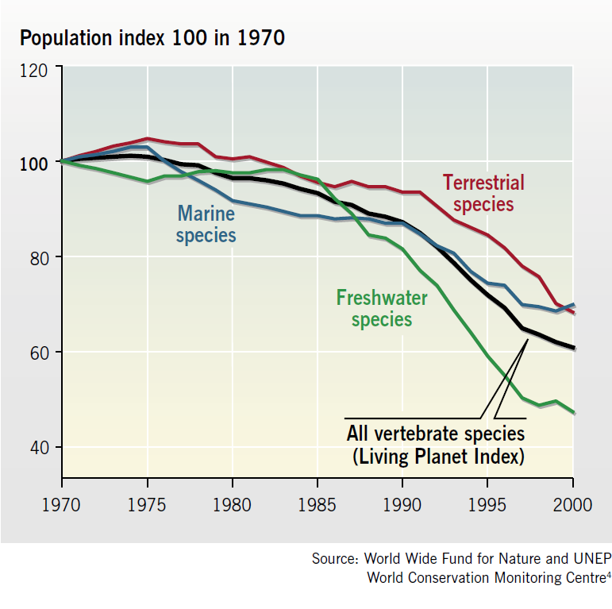
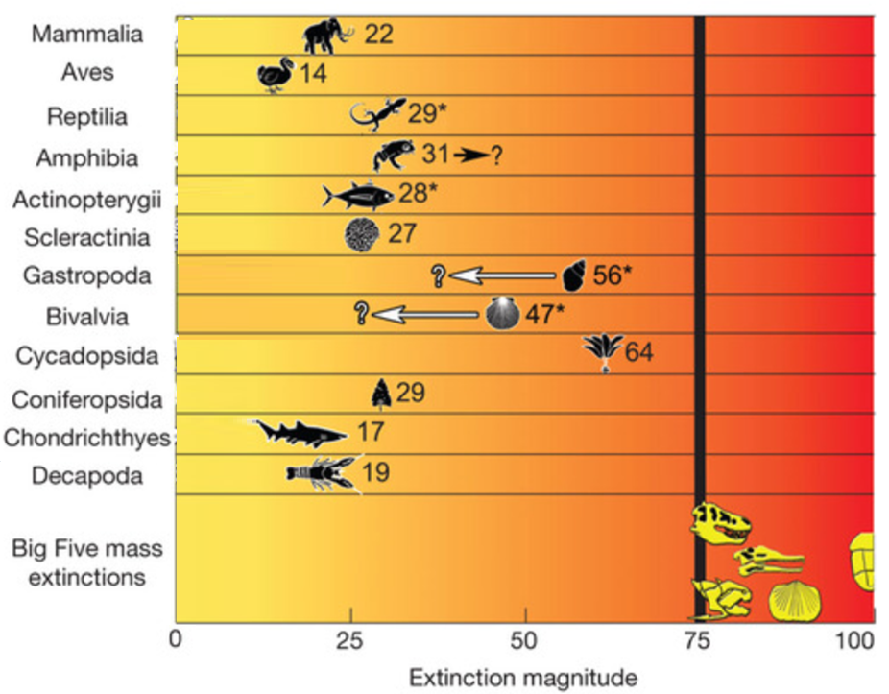
Are we in the verge of the sixth mass extinction?
Only 1 to 2 percent of all species have gone extinct in recent decades
'endangered' and 'vulnerable' categories
‘critically endangered’
2050
2100
However
Barnosky et al., Nature 2011

Slide 13
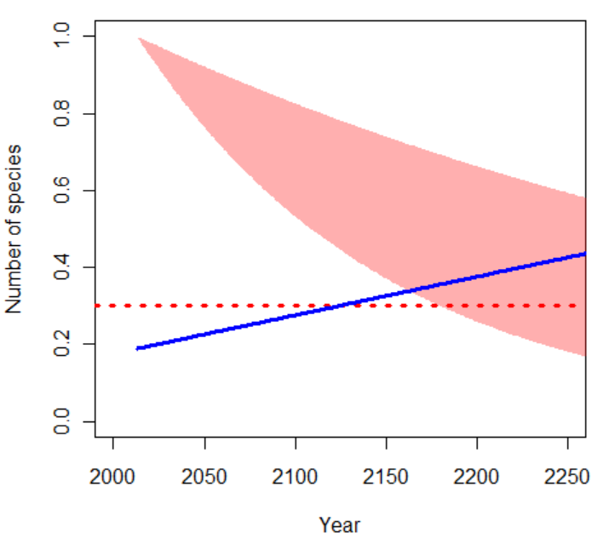
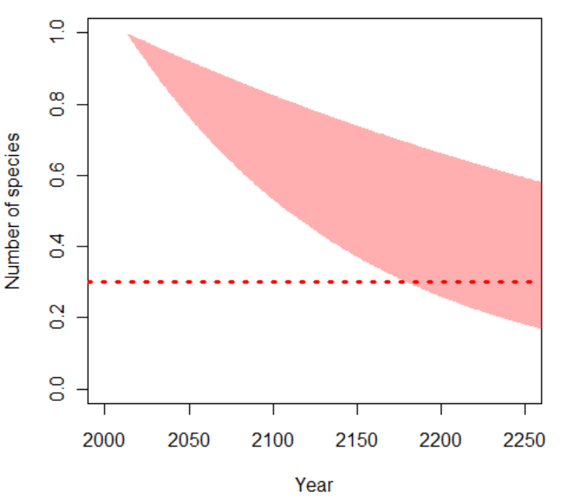
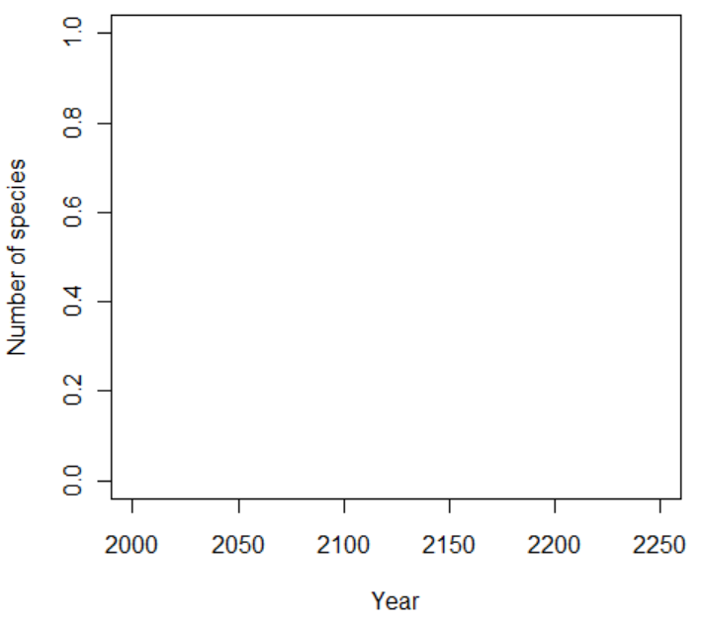
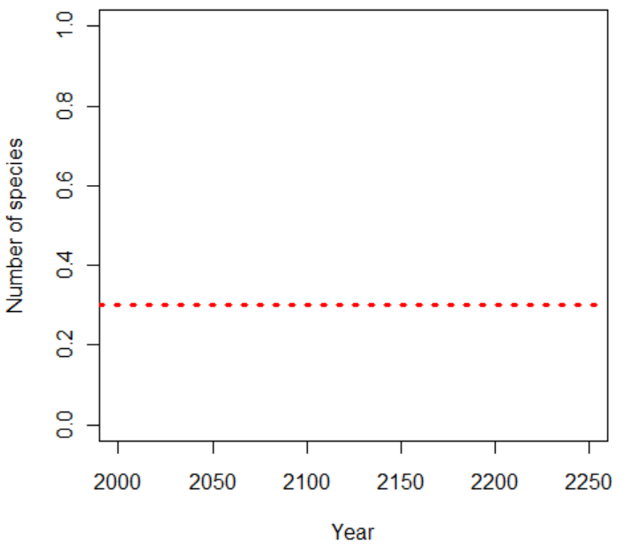
…Balance between current extinction and species description…
Many species will be gone before we get to know they ever existed
8 mil ?
5 mil ?
0.22% / y
0.72% / y
Mass extinction event
8,000 species per year
Mora et al., Science (2013)

Slide 14
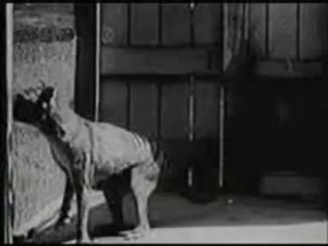
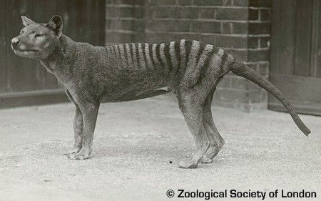
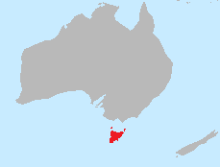
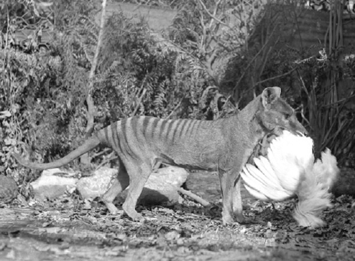
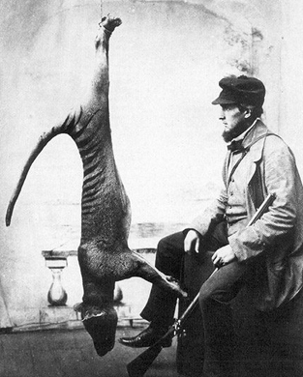
A tail of extinctions: Tasmanian Tiger (Thylacinus cynocephalus)
The Thylacine, and its decedents, were around for about 4 million years
The last known wild Thylacine was shot and killed in 1930
It was the largest carnivorous marsupial of recent times, was abundant and broadly distributed in Tasmania till about 1800’s
The last known living Thylacine (in captivity in the Hobart Zoo) died September 7th 1936
Tasmanian law was introduced in 1936 to protect the Tasmanian tiger
Livestock killer
Wiped out by man in less than 200 years

Slide 15
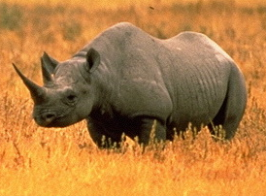

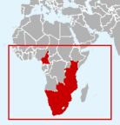
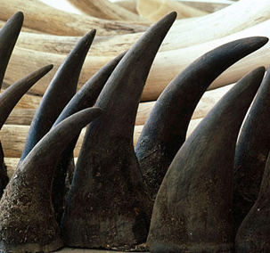

A tail of extinctions: Western Black Rhino (Diceros bicornis longipes)
The Western Black Rhino roamed the planet for the last 50 Mio yrs
There have not been any reports of any sightings or signs since 2006
By 1960, there were more than 100,000 individuals in the wild in Africa
Supposedly a medicine asset. On the streets a kilogram is ~$65,000, more expensive than gold, platinum and in many cases cocaine..."
Declared extinct in the wild in 2011
Wiped out by man in less than 40 years

Slide 16





A tail of extinctions: Golden toad (Bufo periglenes )
Croaking in South American forest for the last 65 million years
No golden toads have been seen since 1989
In 1987, more than 1500 golden toads were observed during the breeding period
Climatic change, pollution, ultraviolet radiation, and fungal skin infections
Declared extinct in 1992
Wiped out in less than 30 years

Slide 17




A tail of extinctions: Caribbean Monk Seal (Monachus tropicalis)
Discovered during Christopher Columbus' second voyage to the New World in 1494. Population estimated at 250.000 individuals
The last confirmed sighting in 1952, protected by law in 1967, declared extinct in 2008
Killed mainly for their blubber, which was processed into oils, used for lubrication, and applied as a coating on the bottom of boats
Wiped out in less than 300 years

Slide 18

















Few others no longer with us…
Puhielelu Hibiscadelphus
Hawaiian Honeycreeper
Black Spotted Damselfish
Liverpool Pigeon
Angel shark
Bezule
Caspian tiger
Alaotra Grebe
Atitlán Grebe
Eastern Cougar
Extinct 1981
Extinct 2004
Extinct 1970
Extinct 2008
Extinct 2011
Extinct 1930
Steller's Sea Cow
The Quagga
Great Auk
Pyrenean Ibex
Cape Lion
Extinct 2010
Extinct 1970
St. Helena Olive
Extinct 1989
Blue walleye
Extinct 2011
Extinct 1741
Extinct 1900s
Extinct 1840
Extinct 2000
Extinct 1963
Extinct 2003
Extinct 1983

Slide 19

Challenges to determine an extinction
Proving that any individual species has gone extinct demands long, fruitless searching
Yangtze River dolphin
(Lipotes vexillifer)
Last sighting in 2002
Almost declare extinct in 2006 BUT, a blurry video gave experts pause, and it was rated "possibly extinct."
There is not confirmation of complete extinction yet

Slide 20



So when do we declare a species extinct?
Raphus cucullatus (Dodo)
Mauritius
The last confirmed sighting was 1662
BUT
when a species becomes increasingly rare before its final extinction, it may continue to exist unseen for many years — so the time of its last sighting may be a poor estimate of the time of extinction.
Latest sights
1598,
1601,
1602
1607,
1611,
1628,
1631,
1638,
1662
1690
Roberts & Solow, Nature 2003

Slide 21



So when do we declare a species extinct?
Probability of extinction, (Dulvy et al. Fish & Fisheries 2004)
n: the number of time intervals in which the species was observed
T: the total number of intervals sampled
tc: the total number of intervals sampled up to the time the species was last observed
T= 1994-1964 = 31
n = 9 years
tc = 25
The last sturgeon was recorded in the 25rd year of the record span
The probabilities that sturgeon is locally extinct from the James River is 0.856

Slide 22

So when do we declare a species extinct?
Time to extinction (Ward-Paige et al., PlosOne 2010)
Whenever a population is expected to reach zero density

Slide 23

How hard is to recover from extinction?
end-Triassic
End-Ordovician
Cretaceous-Tertiary
Kirchner & Weil, Nature 2000
The historical record suggest that on average recovering from an extinction event takes up to 10 million years….so
….today's anthropogenic extinctions will diminish biodiversity for millions of years to come.
(Kirchner & Weil, Nature 2000)

Slide 24










Eastern Island: a tail about the consequences of extinction
Colonized by Polynesians any where between 300 and 1200 CE
21 species of trees and multiple species of land birds existed at the time
Most land species went extinct
Land species used excessively
No wood for boats
…no fishing
…no scape
No food
Cannibalism
Species were harvested faster than they could be replenished
Notes:
But there is another twist to the story

Slide 25
Extinction is seriously forever

